Slide 1
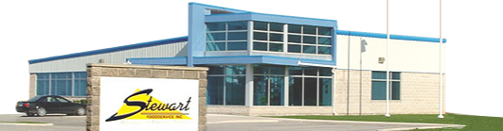
Stewart Foodservice Inc. POS in Beirut, Lebanon
Coursera Capstone
By Ayham Mhd

Slide 2
Introduction

Slide 3

Stake holder overview
Stewart Foodservice is owned by industry veteran Aubrey MacMillan. He started out in the business over 50 years ago at Burgess Wholesale, then an egg-grading station, working his way up through deliveries, sales and management to owner of what has become one of the leading Canadian owned foodservice distributors.

Slide 4
Problem Definition
This company, who supplies restaurants and so on, decided to open a store or a point of sale POS in Beirut, Lebanon, and asked me an engineer having some background in data science that collected from IBM data science courses on Coursera, to suggest the place where to install this POS.

Slide 5
Initial thinking
As the company is the first point in food industry supply chain, and because the distance between the supplier and the client can shorten the time to market (TTM) which is a cost, in addition, the more this distance the more the cost of delivery, so I thought that selecting the right closest place of POS to the targeted market (restaurant, coffee shops and so forth) could be the most important factor.
__________________________________________________________________________
TTM is the length of time it takes from a product being conceived until its being available for sale (Wiki)

Slide 6
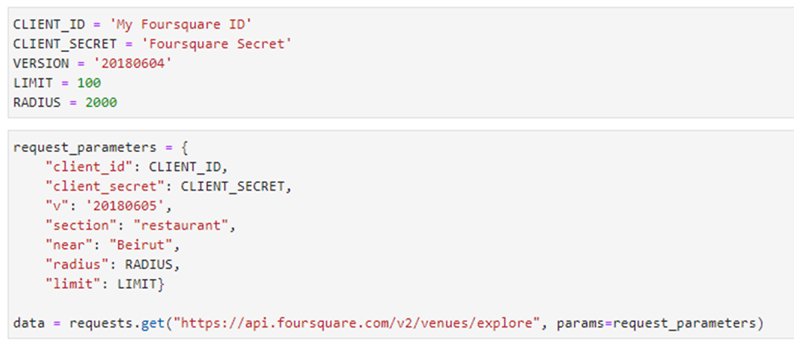
2. Description of data
I’ve collected data from Forsquare API using my credentials like the following

Slide 7
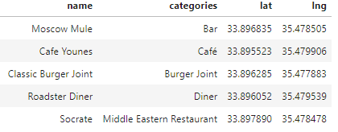
2. Description of data
This gave me a comprehensive data enabling me to extract many meaningful pointers, I extracted the data filtered as I want certain categories of venues, i.e. only related to targeted customers who are restaurants, coffee shops and so forth, and I chose the following useful fields: name of venue, category, longitude and latitude as the following:

Slide 8
3. Methodology
It was a descriptive research consists of the following steps after introductory part:
3.1. Preparing the environment
I used numpy to handle data in a vectorized manner, and will use pandas library for data analysis and json library to handle JSON files, and will use geopy to be able to use geocoders.Nominatim to convert an address into latitude and longitude values, and requests library to handle requests, and json_normalize that will transform JSON file into a pandas data frame.
I used Matplotlib and associated plotting modules, and k-means for clustering stage.
Then I used folium map rendering library.

Slide 9
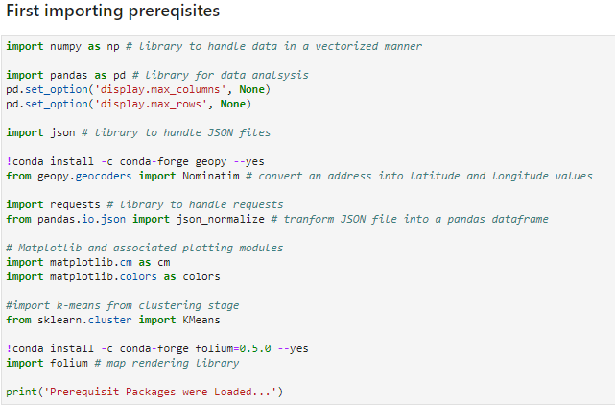
3.1. Preparing the environment
I used numpy to handle data in a vectorized manner, and will use pandas library for data analysis and json library to handle JSON files, and will use geopy to be able to use geocoders.Nominatim to convert an address into latitude and longitude values, and requests library to handle requests, and json_normalize that will transform JSON file into a pandas data frame.
I used Matplotlib and associated plotting modules, and k-means for clustering stage.
Then I used folium map rendering library.

Slide 10
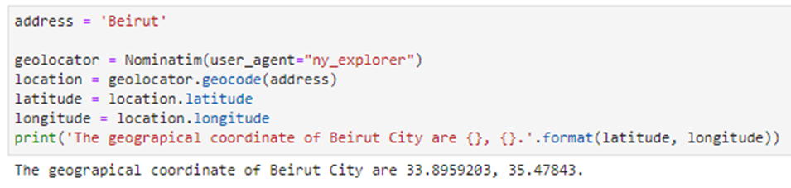
3.2. Exploring Beirut City
I used geopy library to get the latitude and longitude values of Beirut City,

Slide 11
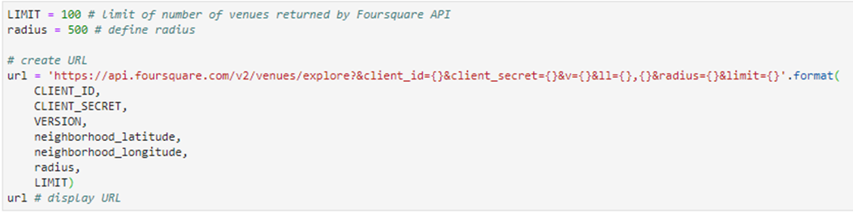
3.2. Exploring Beirut City
then using my Forsquare credentials I got the top 100 venues that are in Beirut within a radius of 500 meters.
Then I used a function that extracts the category of the venue then clean the json and structure it into a pandas data frame.

Slide 12
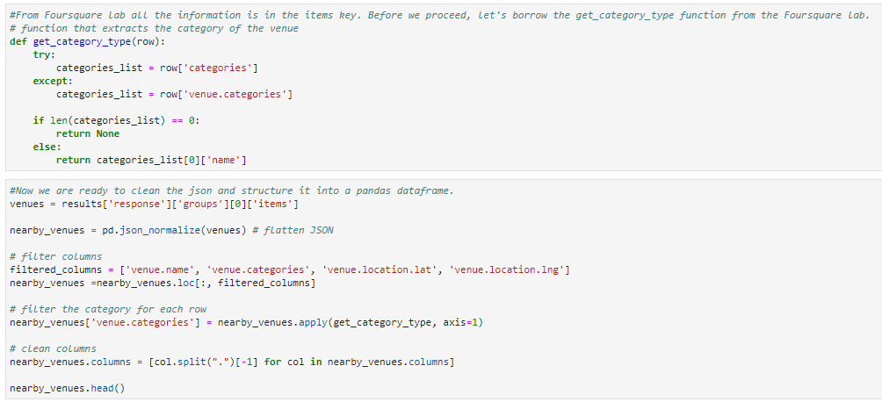
3.2. Exploring Beirut City
Then I used a function that extracts the category of the venue then clean the json and structure it into a pandas data frame.

Slide 13
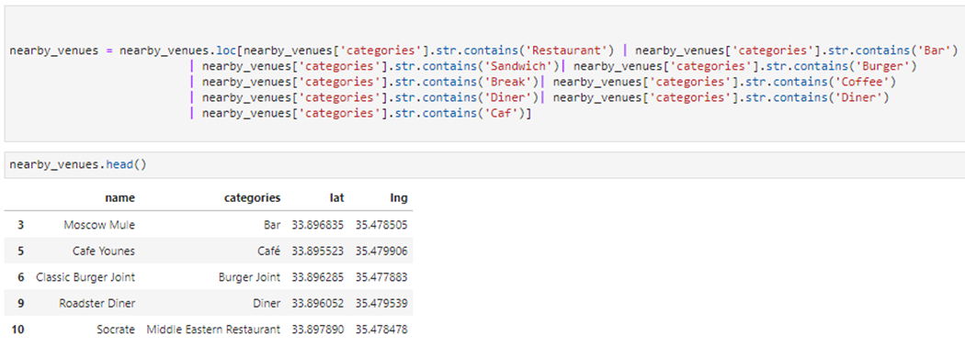
3.2. Exploring Beirut City
Then I filtered the result categories to match our target (Restaurants and etc.)

Slide 14
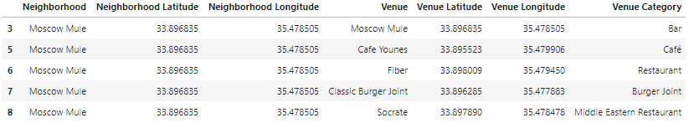
3.3. Exploring Neighborhoods
I used a function to repeat the same process to all the neighborhoods in Beirut using Foursquare API as well, creating a new data frame which also must be filtered.

Slide 15
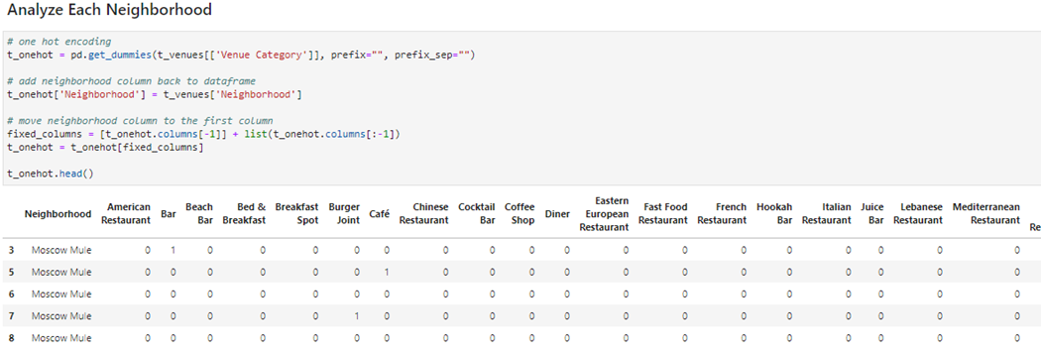
3.3. Exploring Neighborhoods
Then I analyzed each neighborhood by one hot encoding.

Slide 16
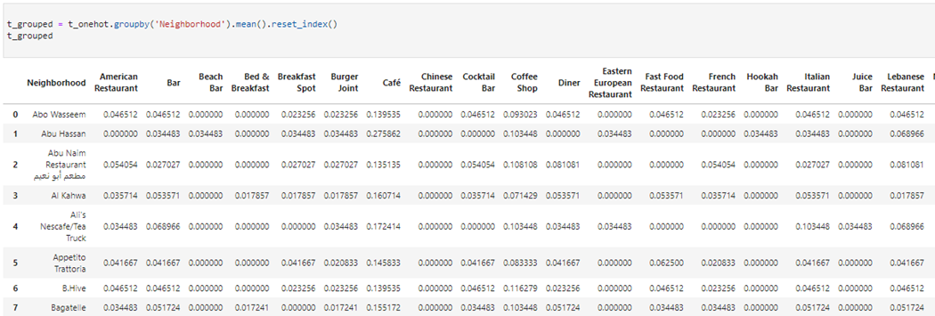
3.3. Exploring Neighborhoods
Then grouping rows by neighborhood by taking the mean of the frequency of occurrence of each category, then putting that into a pandas data frame.

Slide 17
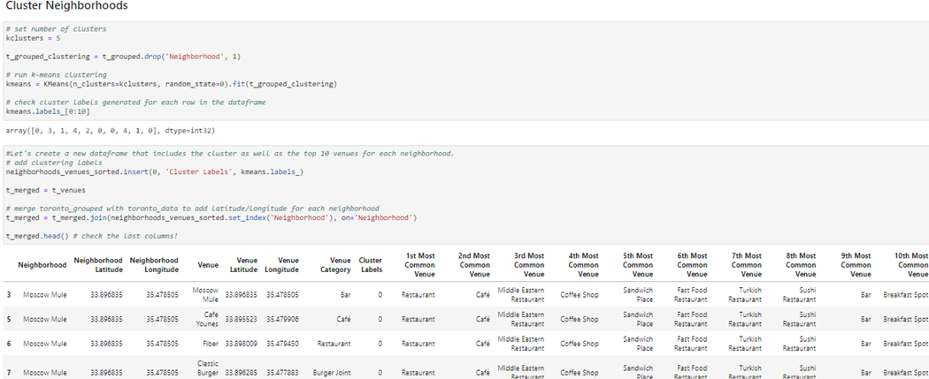
3.4. Clustering Neighborhoods
I clustered neighborhoods using Kmean as following:

Slide 18
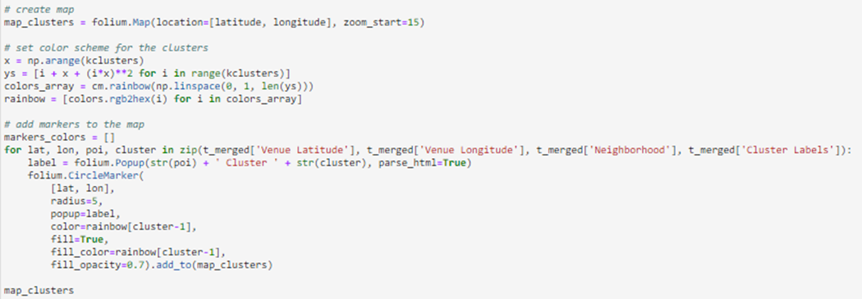
3.4. Clustering Neighborhoods
and visualize the resulting clusters using Folium library:

Slide 19
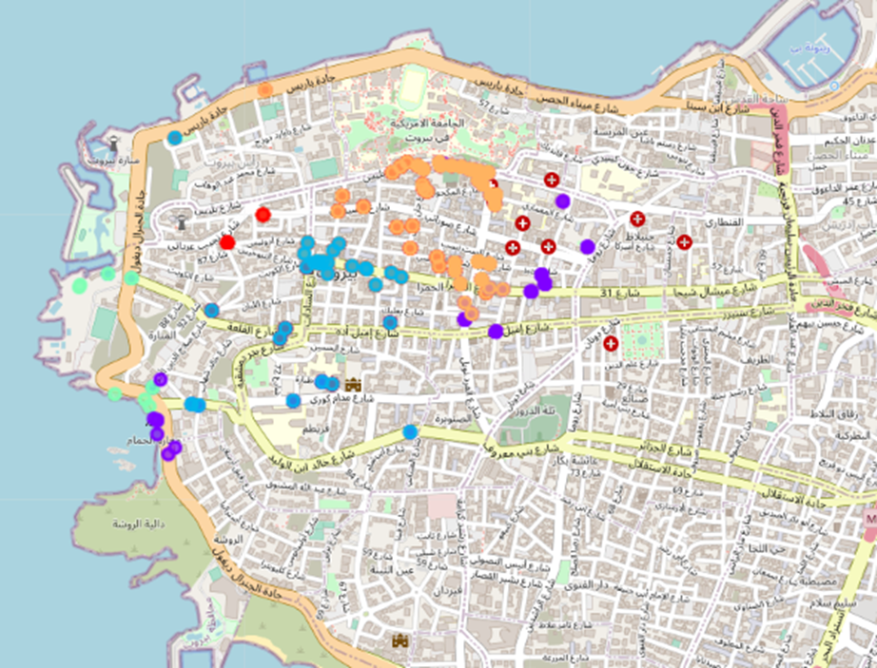
3.4. Clustering Neighborhoods
and visualize the resulting clusters using Folium library:

Slide 20
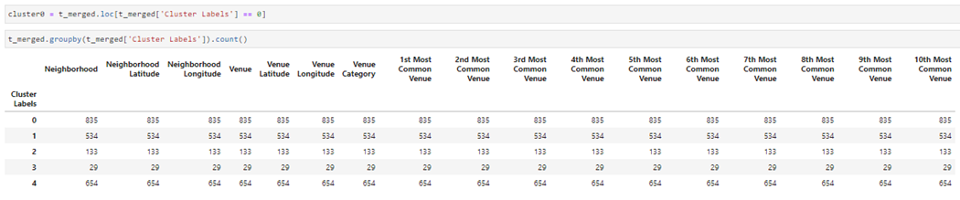
4. The Result
I chose the cluster that have the largest number of neighborhoods, get the average coordinates to plot the suggested POS location, this way it will be close to maximum number of the customers, and by this way I can consider that I had chosen the optimal place for the POS because of reducing TTM and delivery and shipping fees.

Slide 21
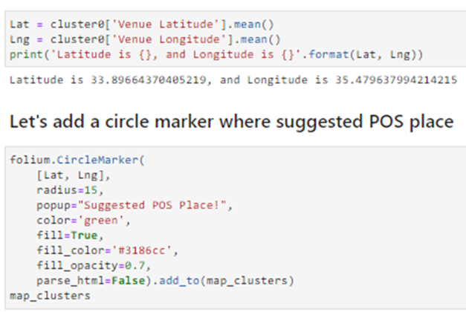
4. The Result

Slide 22
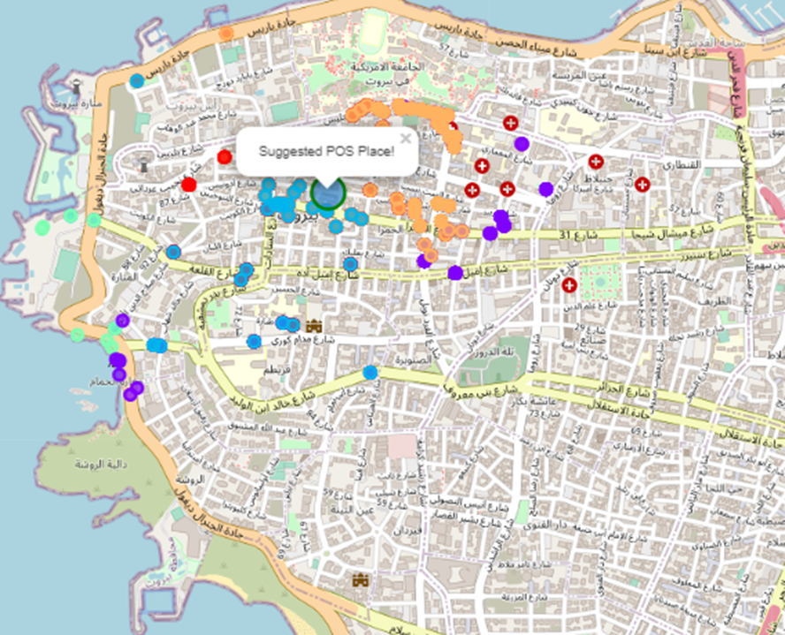
4. The Result

